Slide 1

Yellow Heart Cryptocurrency

Slide 2

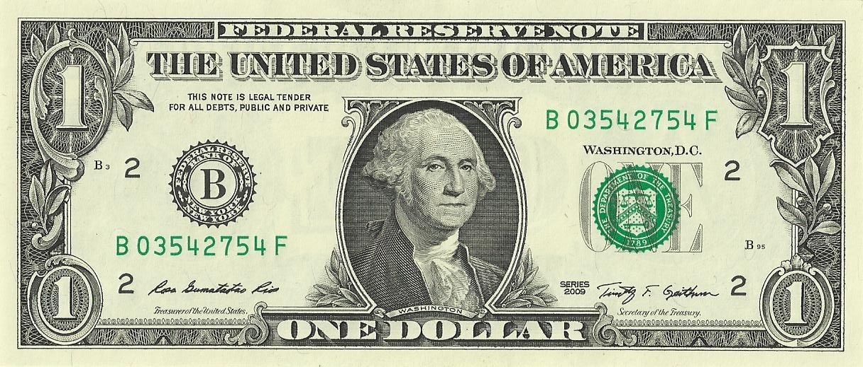
What is Money?
Currency is a medium of exchange for goods and services.
What makes it valuable?

Slide 3
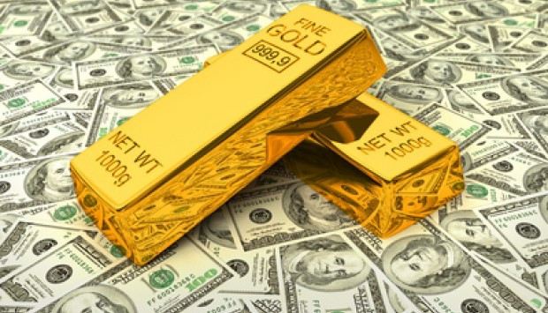
Built on a System of Trust
Originally US dollar backed by Gold
Gold was scarce and precious
Inherit value
Now it is backed by trust
Precious
Scarcity is artificial
Value as it allows to purchase goods

Slide 4
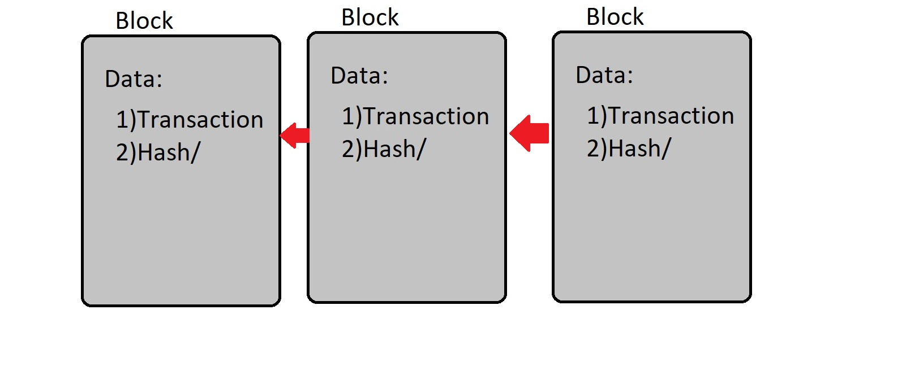
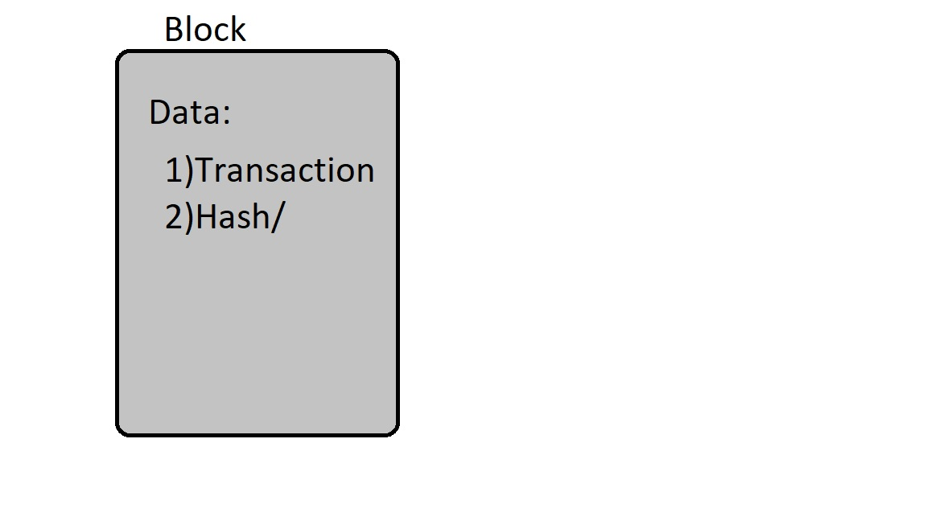
What is block Chain?

Slide 5
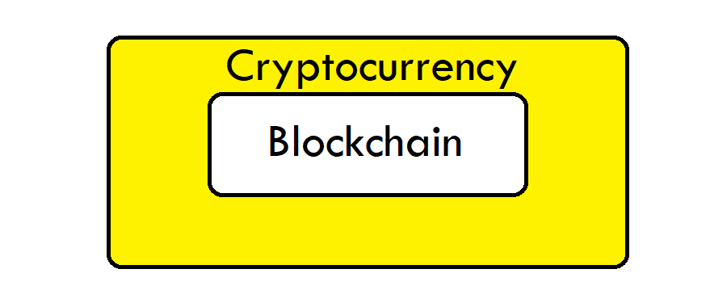
Blockchain is the Foundation

Slide 6
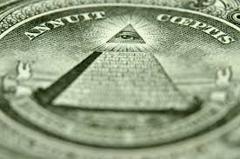
Creating a value system
Requires trust
How can trust be created?
Scarcity can be used

Slide 7
How does Cryptocurrency create a value system
Encryption
Difficult to falsify money (e.g. use the same bit coin to pay 2 different people)
Inability to be seized or frozen
Decentralization is the reason for this
Asset
An asset akin to stock that rises and decreases in value.

